Slide 1

Machine Learning Taster
Alan Beavan

Slide 2


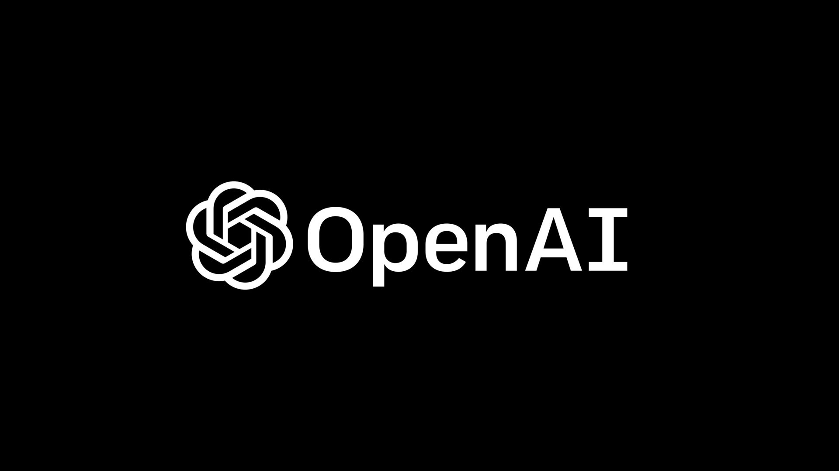

Machine learning

Slide 3
Session aims
We are biologists that use computers – not computer scientists
We will focus on ML applications
This requires understanding of the algorithms but not of the highly technical details
We will go through some implementation but for your own data, you will have to think hard about how to analyse it.

Slide 4

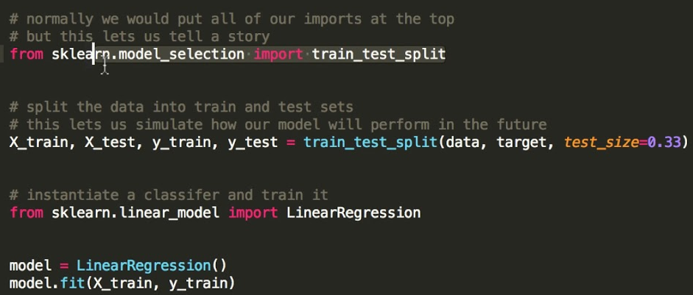

Slide 5
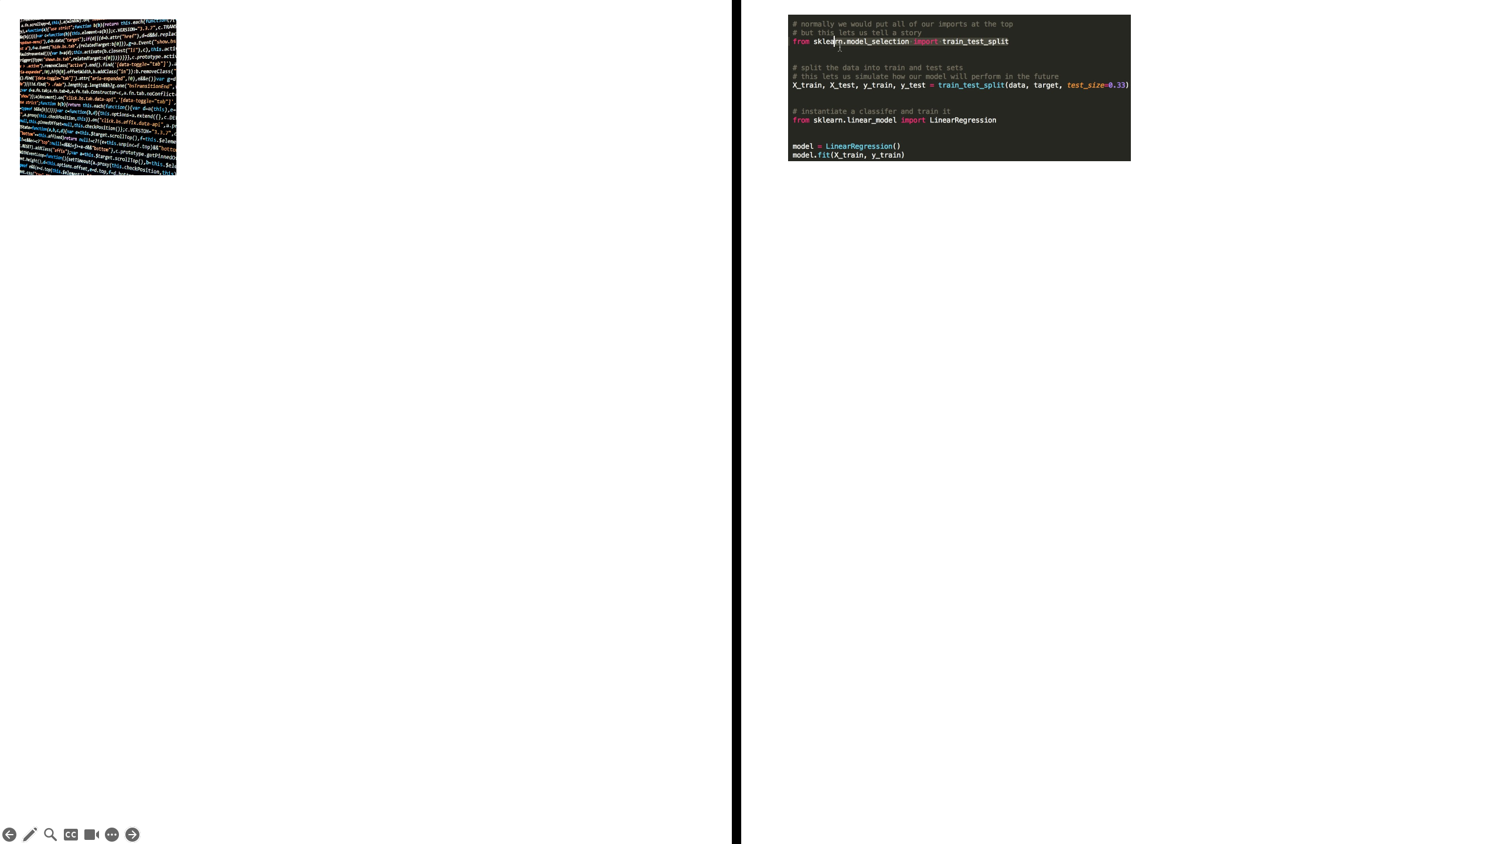
Requires well thought out code
Short code, relatively easy to write
Can help our understanding more
Will often provide cryptic explanations
Logical
Statistical
Difficult to tackle highly complex problems
Just chuck information at it
Ethically more or less sound
Angers people like Nick Cave
Notes:
Example 1 – spell checking program – either give it a load of rules or just tell it to figure out the rules
Example 2 + 3 – Conventional programming can give us straight answers i.e. you get the answer because of this condition. Machine learning will often twist and contort the data in complex ways that make it near impossible to say why you are able to accurately model some variable (not always)
Example 4 – The whole point in machine learning is that it has a sort of intuition and can identify things that are difficult to define. For example, language models that you’re all familiar with
Example 5 – serious point to be made about using off the shelf machine learning programs such as chatGPT that mine published work for their models but for creating your own machine learning algorithms, almost certainly fine.

Slide 6
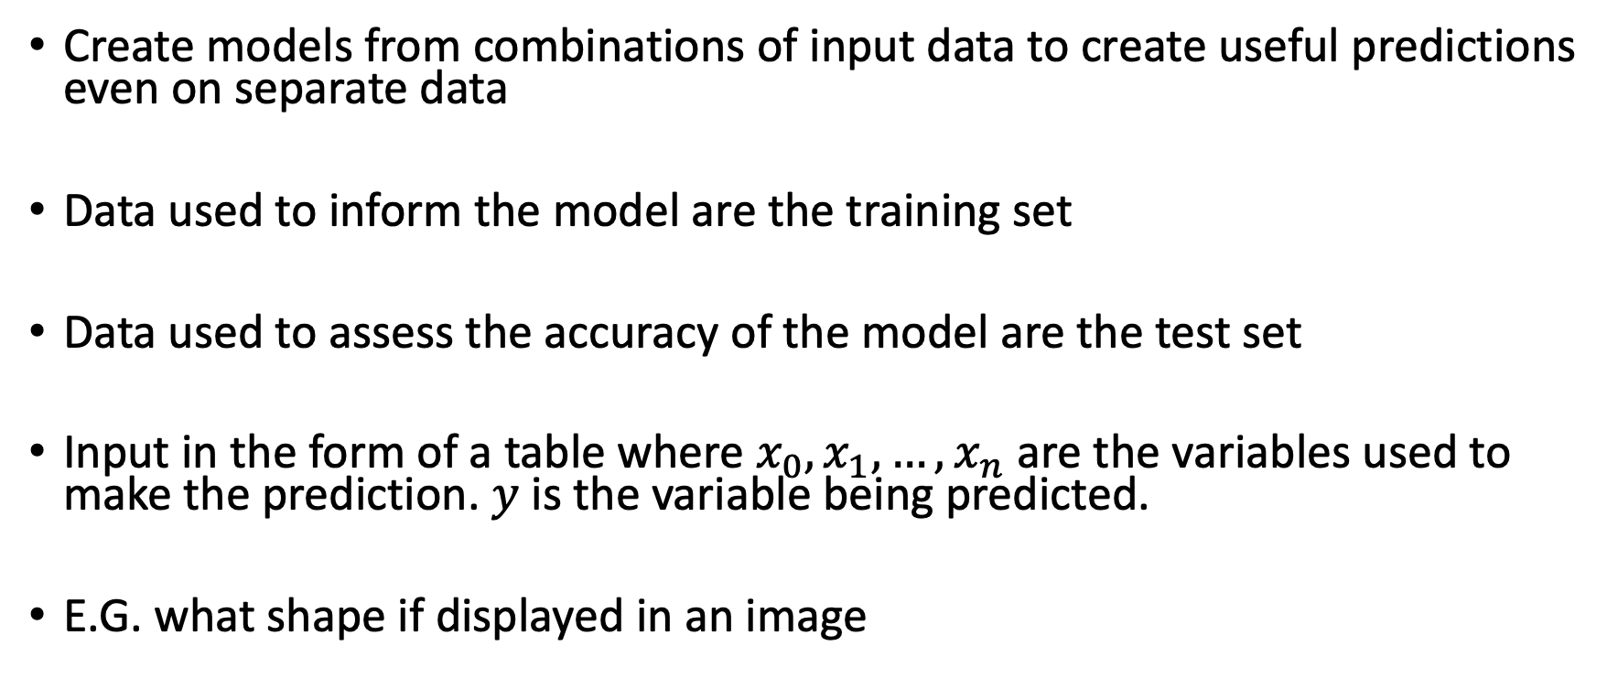
Machine Learning - Supervised
Create models from combinations of input data to create useful predictions even on separate data
Data used to inform the model are the training set
Data used to assess the accuracy of the model are the test set
Input in the form of a table where $x_{0},x_{1},…,x_{n}$ are the variables used to make the prediction. $y$ is the variable being predicted.
E.G. what shape if displayed in an image

Slide 7
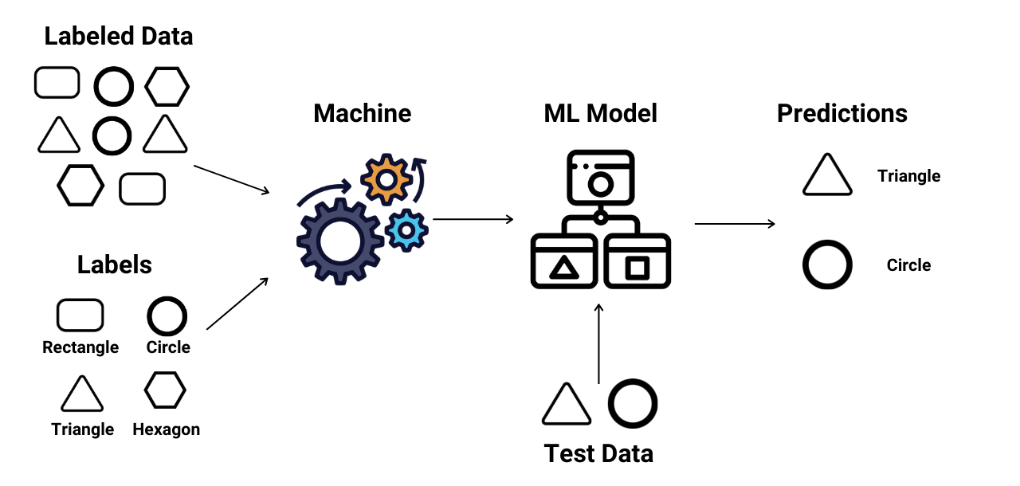
Typical Supervised Pipeline
https://www.enjoyalgorithms.com/blogs/supervised-unsupervised-and-semisupervised-learning

Slide 8
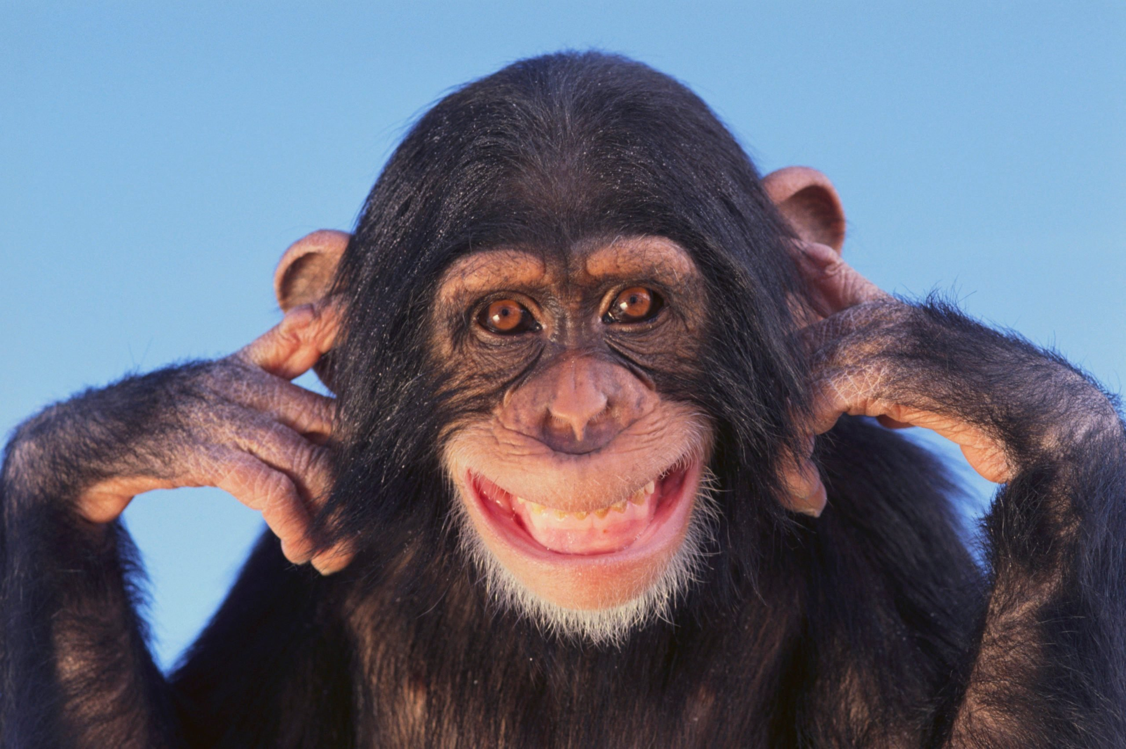
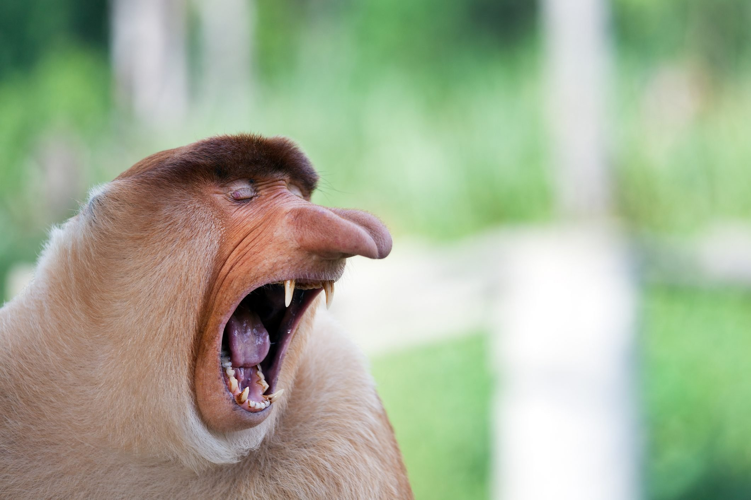
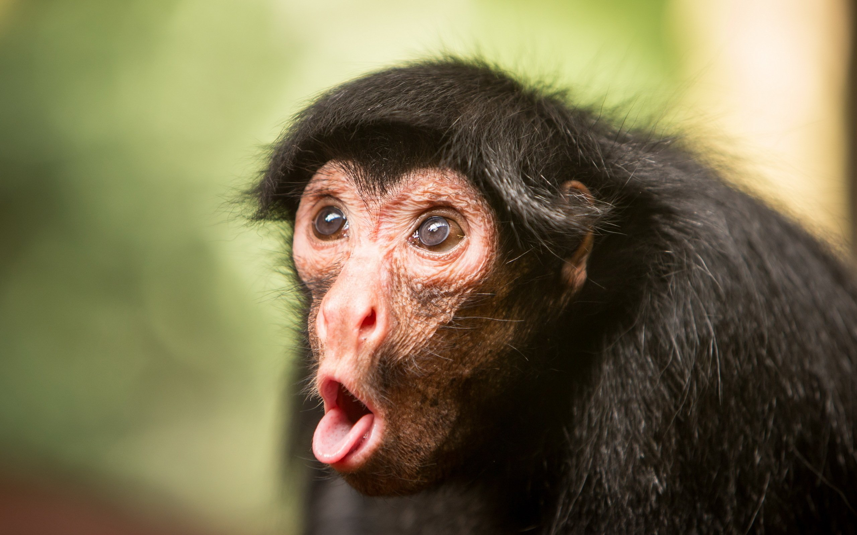

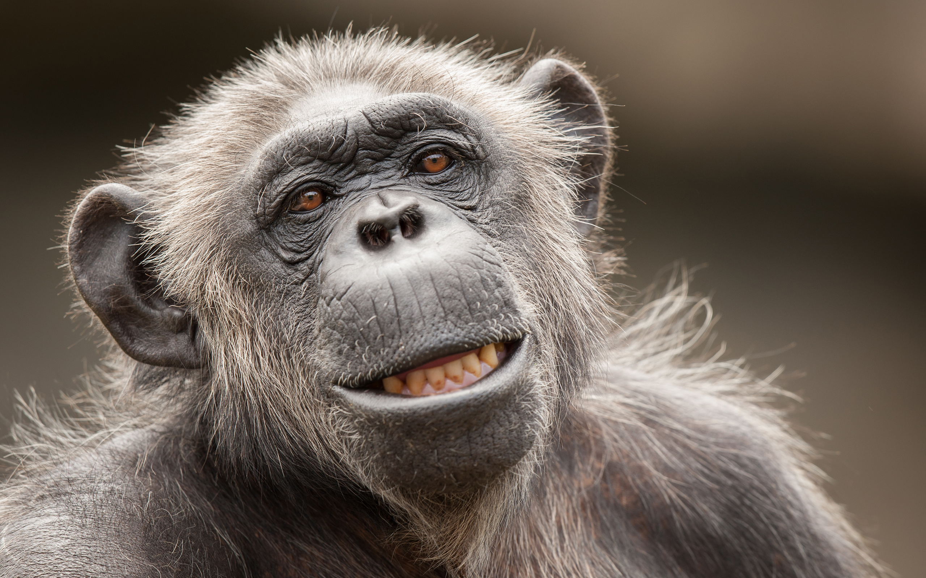

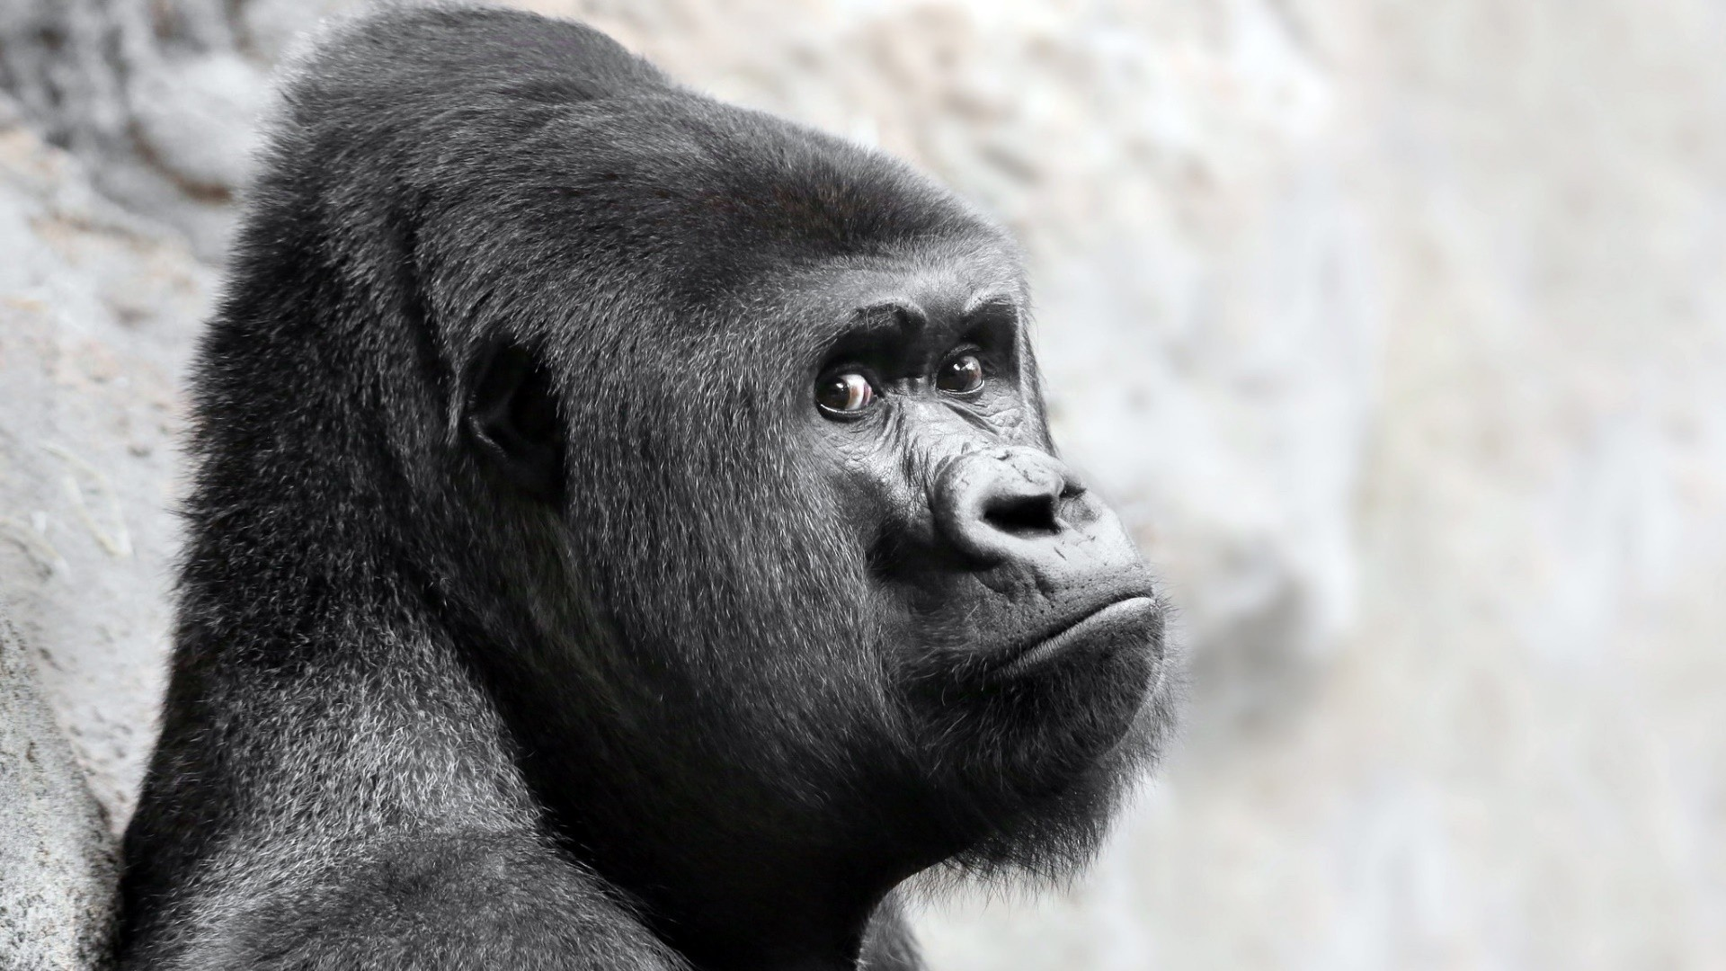

Typical Supervised Pipeline
Gorilla gorilla
Homo sapiens
Allochrocebus solatus
Gorilla gorilla
Homo sapiens
Lemur catta
Leontopithecus chrysomelas
Pan troglodytes
Papio hamadryas
...
Xanthonycticebus pygmaeus

Slide 9
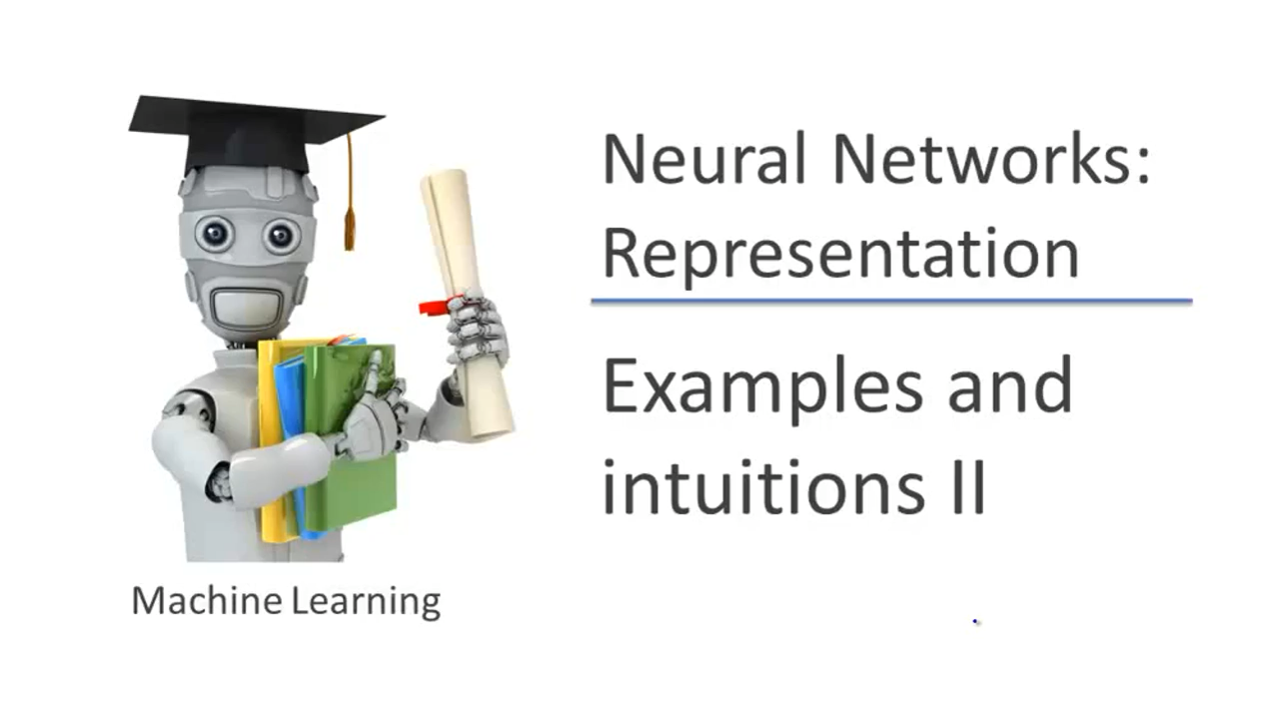
https://www.coursera.org/learn/machine-learning-course/home/week/1
Notes:
MINST dataset released in 1999

Slide 10
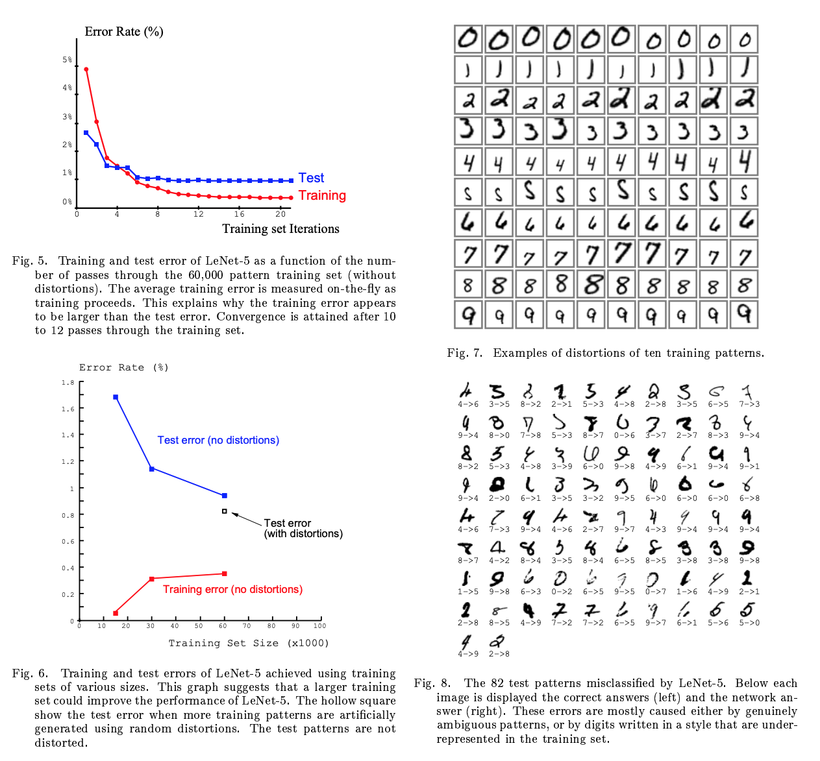
LeCun et al. 1988

Slide 11
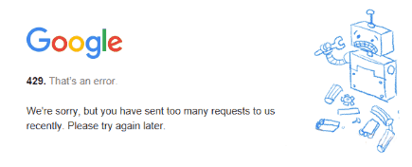
Machine Learning - Unsupervised
Builds models based on unlabeled data.
For example, to split data into separate categories or anomaly detection in computer systems
The dichotomy between supervised and unsupervised is a bit overstated but it’s a useful thing to think about.

Slide 12
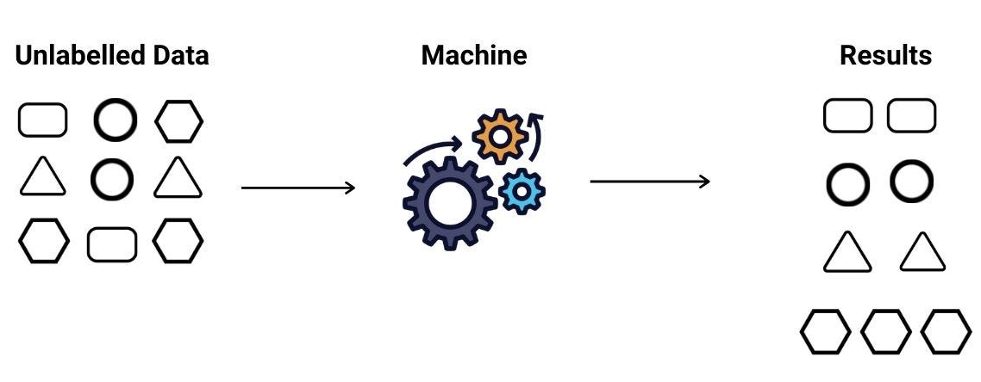
Machine Learning - Unsupervised

Slide 13
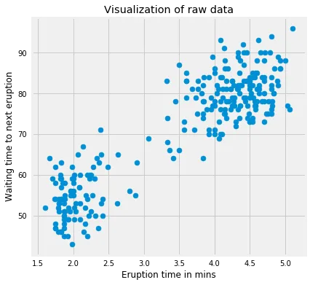
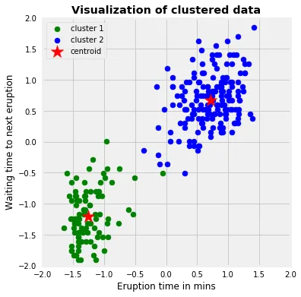
Unsupervised Example - K-Means Clustering
https://towardsdatascience.com/k-means-clustering-algorithm-applications-evaluation-methods-and-drawbacks-aa03e644b48a
Notes:
n observations are condensed in k clusters
Finds natural splits in the data that minimise the average difference between the datapoint and the mean for a cluster
Expanded algorithms can not only find the clusters but also estimate k.

Slide 14
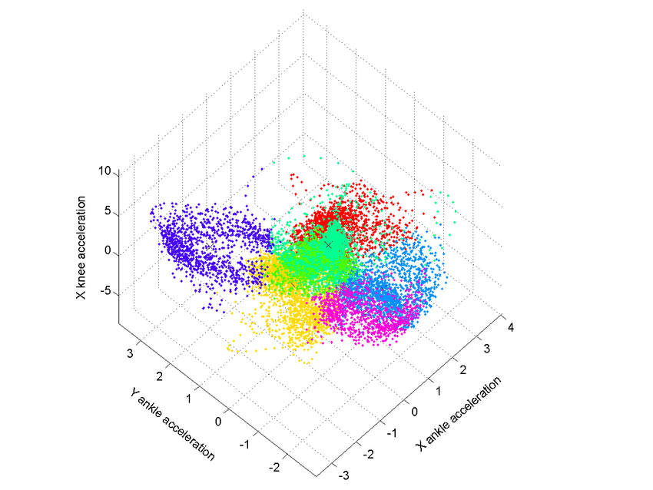

Slide 15

The Midpoint.

Slide 16
Language
Variables → Features
Observations – your data for which we record values for features
Model – the output of the machine learning algorithm which we can then use to make predictions
Accuracy, precision, recall, F1 score – various performance metrics. F1 score is an important combination of precision and recall that is a good measure of performance in unbalanced datasets, which accuracy fails in.
Training set, test set – data partitions used for model inference and testing respectively
Algorithms – K means clustering, Random forest, Neural network
Cost function – a method of assessing the suitability of your ML implementation. Different for each algorithm. Minimised during model fitting.

Slide 17
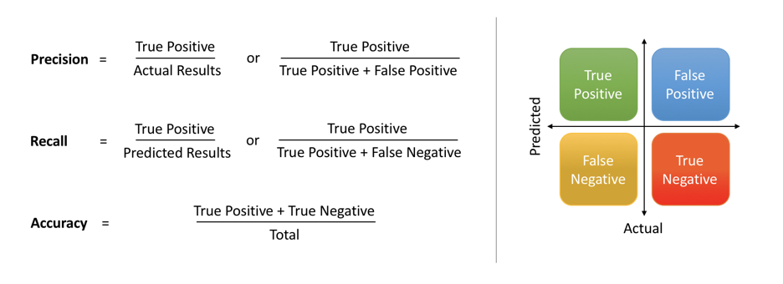
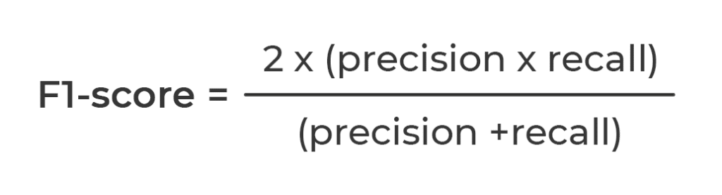
https://medium.com/@shrutisaxena0617/precision-vs-recall-386cf9f89488

Slide 18
Language
Variables → Features
Observations
Model – the output of the machine learning algorithm which we can then use to make predictions
Accuracy, precision, recall, F1 score – various performance metrics. F1 score is an important combination of precision and recall that is a good measure of performance in unbalanced datasets, which accuracy fails in.
Training set, test set – data partitions used for model inference and testing respectively
Algorithms – K means clustering, Random forest, Neural network
Cost function – a method of assessing the suitability of your ML implementation. Different for each algorithm. Minimised during model fitting.
Notes:
Accuracy = the proportion of observations which are called correctly
Precision =

Slide 19
Decisions
Data – what do you need to answer your question and do you have enough?
Algorithms – Can you supervise your learning? How can you say whether your model is a good one? Can you distinguish what goes into your model?
How to split your data into test train and possibly validation sets.
Hyperparameters – For how long do you train your model? Are you overfitting your data? Do you need a validation set?
Notes:
Machine learning may be efficient in terms of code but it is not just a black box to plug your data into thoughtlessly. The decisions you need to make are:
Data – what is it that you want to predict/infer and what data do you want to use to do it?
Algorithms – Loads of machine learning methods exist and all have different pros and cons. Do you want to predict something without being particularly interested in what predicts it? E.g. disease likelihood in medical studies. Maybe a neural network then. Are you more interested in the feature importance Is machine learning even the right method to use?
Test and training set – validation set?
Hyperparamaterisation Validation set is a partition of data that allow you optimise your hyperparameters.

Slide 20
Random forests
Notes:
This is recycled from a method where I used random forests to predict the presence or absence of a gene in a bacterial genome using the presence or absence of other genes in the genome.
Gene is here both the variable being predicted and a feature.
Gene can be replaced with pretty much any measurable thing.

Slide 21
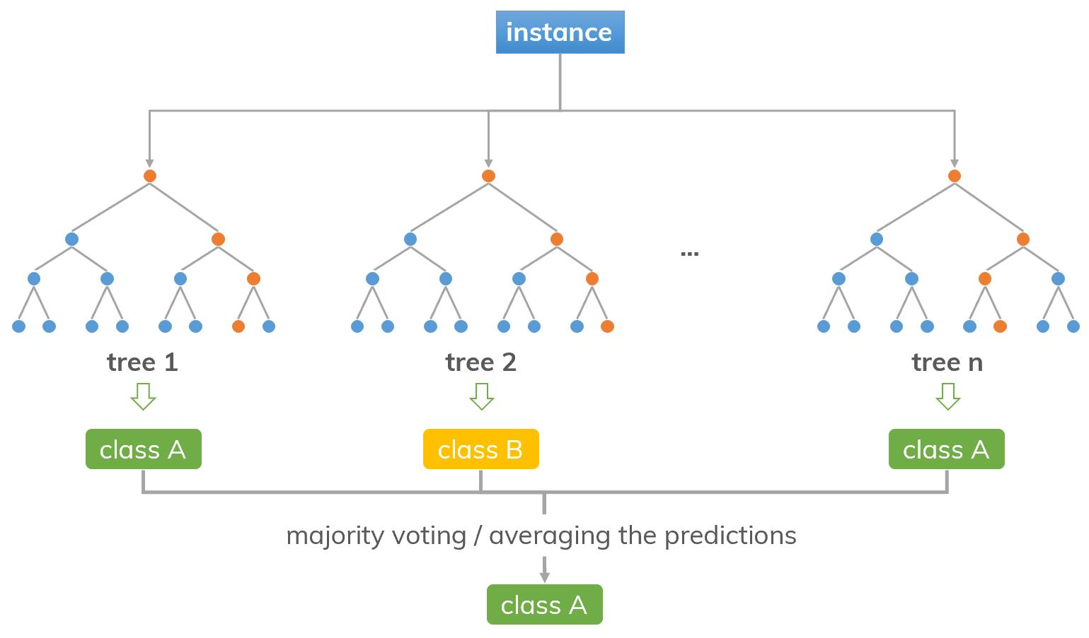
Random forests
https://dinhanhthi.com/random-forest/

Slide 22
Application
1
1
0
0
1
0
1
1
0
1
0
1
1
0
1
0
0
1
1
0
1
1
1
1
0
1
0
0
1
0
1
0
1
1
1
0
1
0
1
0
0
1
0
0
1
0
1
0
0
1
0
0
1
0
0
0
0
1
0
0
0
1
0
1
0
1
0
0
1
0
1
0
1
1
1
0
1
Notes:
Figure *
Patterns to find in training set
Reveal test set, predict, measure accuracy, repeat for every gene.
Double output – for each gene: is it predicted – what predicts it?

Slide 23
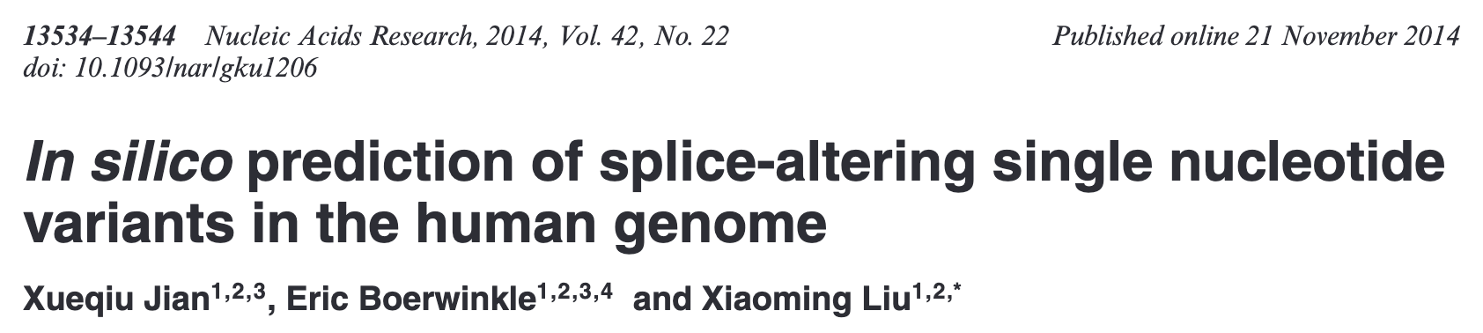
https://academic.oup.com/nar/article/42/22/13534/2411339
Notes:
Predict which nucleotide variants are likely to produce splicing changes.
Found that predicted splice site altering mutations were enriched in known somatic mutations in cancer.

Slide 24
Random forests – hyperparameters
Number of trees
Depth of trees
Minimum purity
Size of random sample from which to decide on your tree node

Slide 25
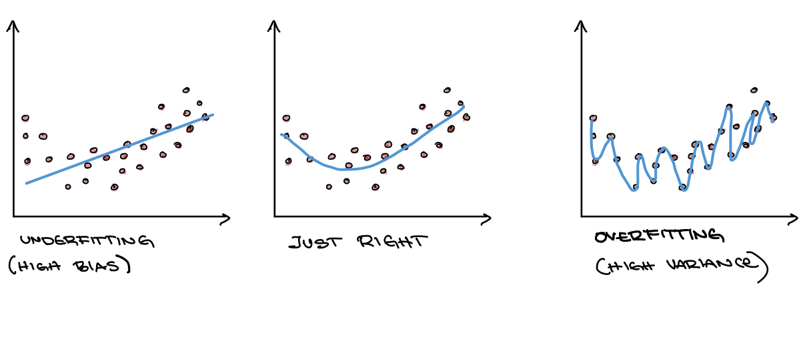
https://carpentries-incubator.github.io/ml4bio-workshop/04-trees-overfitting/index.html

Slide 26
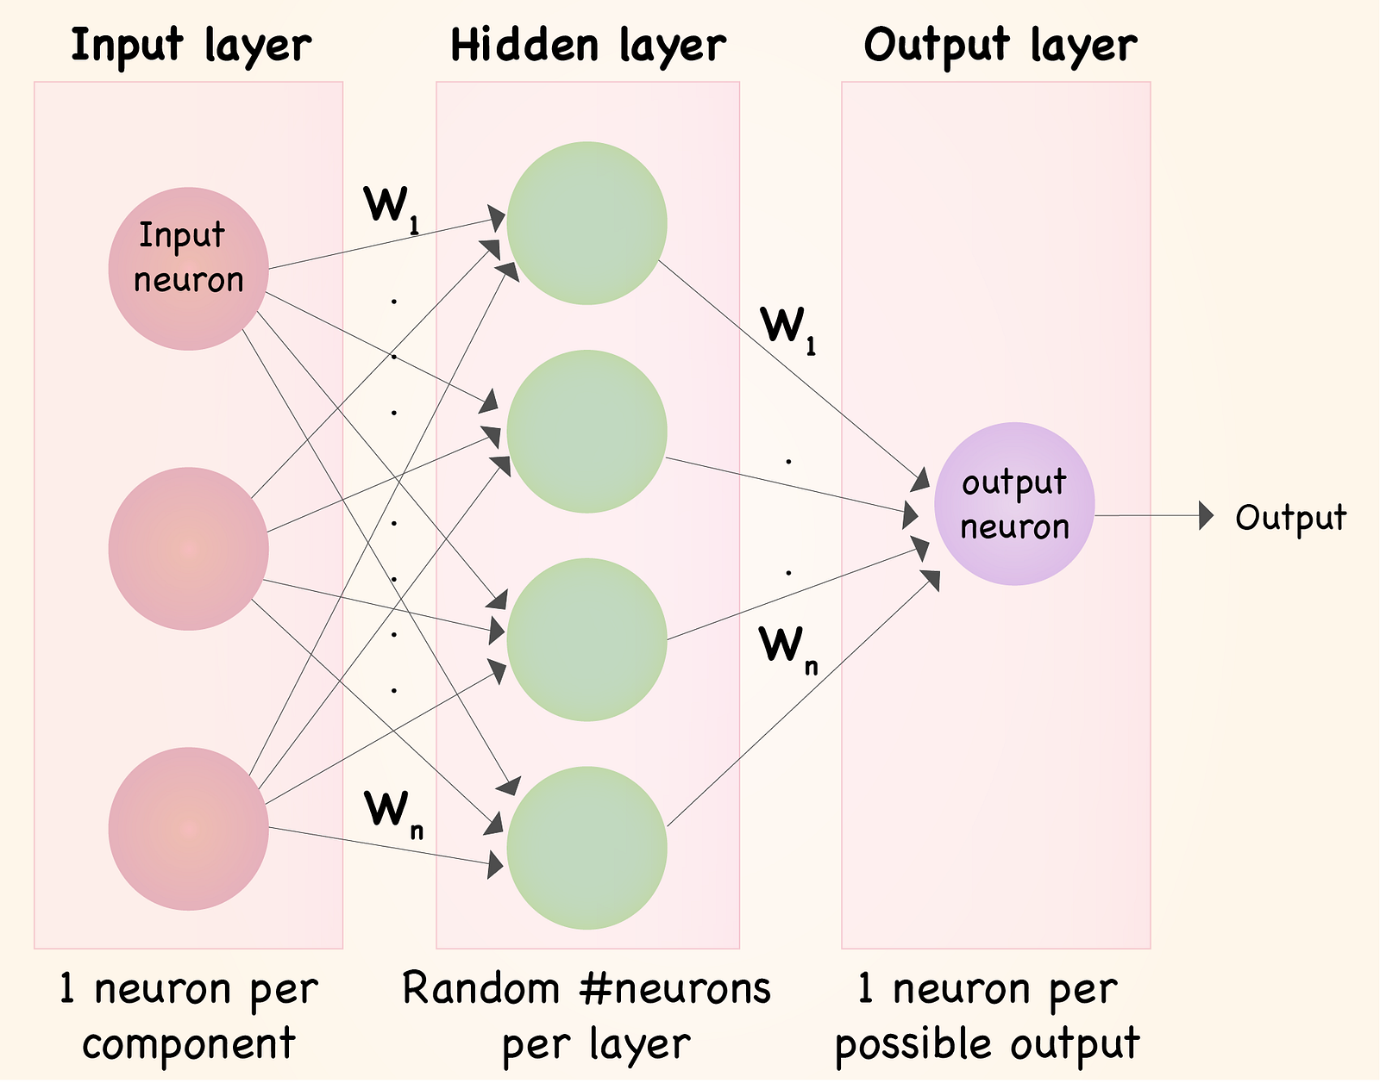
Neural Networks
https://towardsdatascience.com/understanding-neural-networks-what-how-and-why-18ec703ebd31
Notes:
Input layer are your prediction features
These get rearranged through these W1...n hyperparameters into a hidden layer or layers which are sort of abstract combinations of your different features.
Output is a prediction which you can assess using F1 score etc.
If you want to understand more, this will be independent.

Slide 27
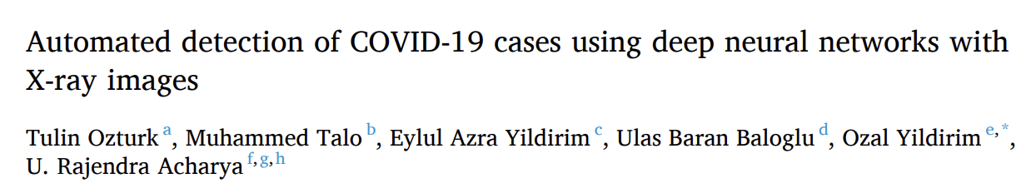
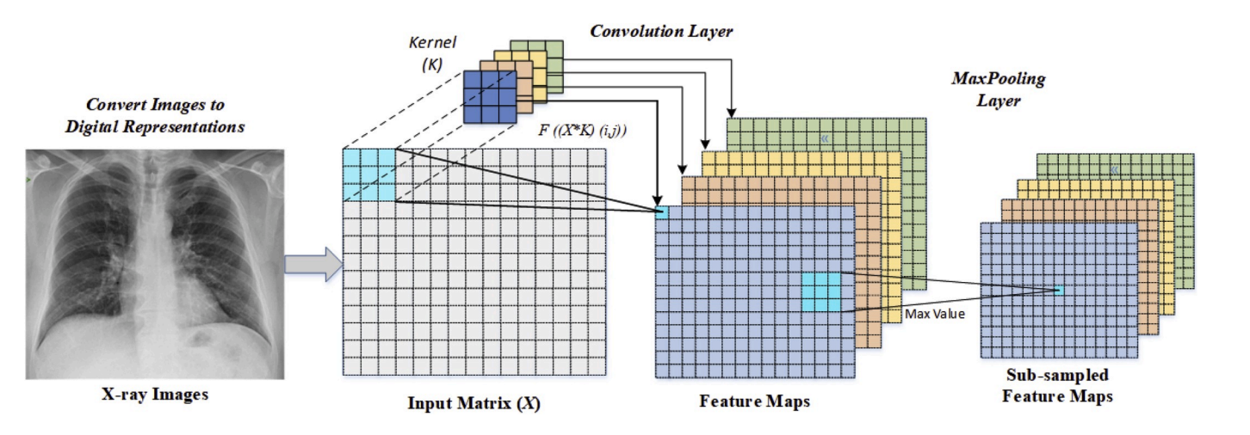
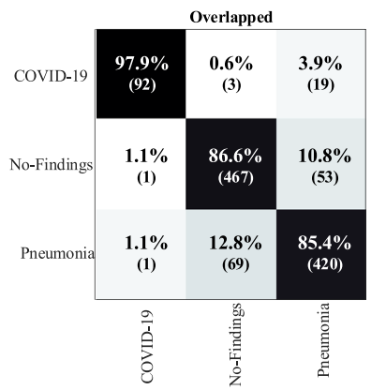
https://www.sciencedirect.com/science/article/pii/S0010482520301621?via%3Dihub
Notes:
Convert x ray scans into digital (list of pixels).
Abstract data through combinatorial layers – model can identify signatures of COVID19 with or without pneumonia
Confusion matrix suggests it does a good job, though far from perfect.
This paper was cited > 1000 times

Slide 28

Language Models
All the rage
Asks: “given what has been said so far, what is likely to be said next” based on internet text databases
Whether something is true is irrelevant
https://www.youtube.com/watch?v=kCc8FmEb1nY&ab_channel=AndrejKarpathy

Slide 29
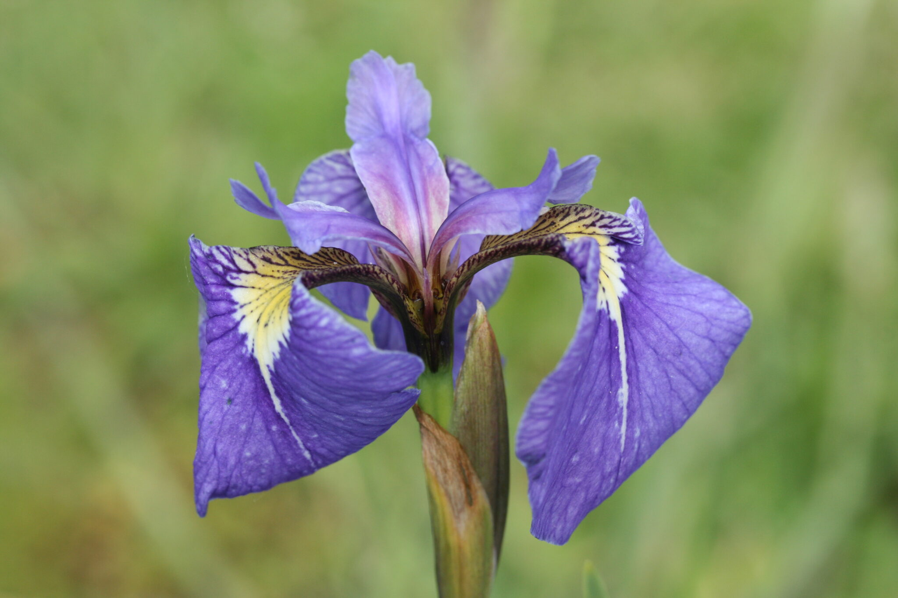
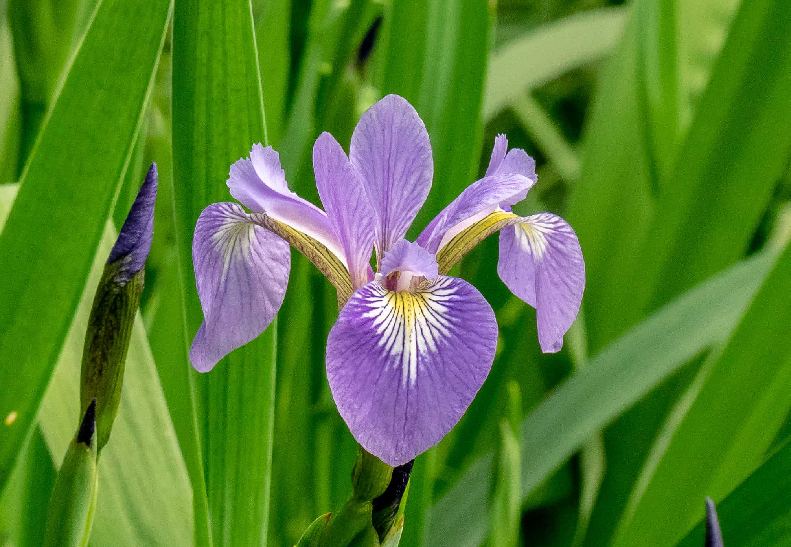
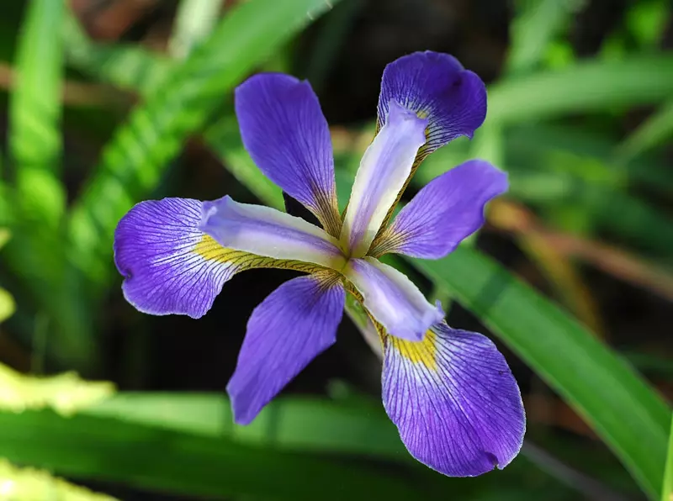
Practical – predicting species from anatomical data
Iris setosa
Famous/notorious Iris dataset compiled by R. A. Fisher
sepal length, sepal width, petal length, petal width, species
Iris versicolor
Iris virginica

Slide 30
Still interested? You’re not the only one.
Thousands of online courses
E.g. https://www.coursera.org/learn/machine-learning/home/welcome

Slide 31
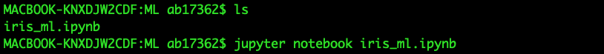

Slide 32
